Slide 1
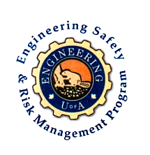
Fundamentals of RM
RM System and Process
Leadership in RM
Incident Investigation
RM Tools & Challenges
RM in Industry
People & Org.
Application and Perspectives
Becoming a Leader in Safety and Risk Management
ENGG404 - Lecture
Chapter 2.1 Why is Risk Management Important?
ESRM - LRM
1
Notes:
ENGG404 Lecture 00 - Day 1
1
1

Slide 2
Learning Outcomes:
Discuss and defend why risk management is important.
Calculate the Injury Frequency Rate
Demonstrate the results of a good risk management program.
Chapter 2.1: The Importance of Risk Management
2

Slide 3
Background:
Historically, deaths and injuries were just accepted as ‘part of the job’.
Current practice evolved to match our current belief that all unwanted events can be prevented or mitigated.
In order to do this, we need to evaluate the risk that an activity presents.
Chapter 2.1: The Importance of Risk Management
3

Slide 4
Why Do We Evaluate Risk?
Remember our PEAP Lecture!
To avoid losses and prevent negative impacts on PEAP
It’s a good investment!
The loaf of bread example
To create sustainability for the business/industry in the future
TBL – The Triple Bottom Line: Environment, Social, Economic Interests
New approach is Quadruple BL: Environment, Social, Economic Interests, AND Risk Management!
Chapter 2.1: The Importance of Risk Management
4

Slide 5
Why is this important to you?
1) CRITICAL to Success!
On your projects / jobs and in your career, your job as an Engineer will be to manage and control risks!
Have a Solid Risk Management Process
Clearly Communicate Risk to Others
2) Avoid Loss Incidents:
Many incidents result from decisions made without proper risk management engagement!
Be Involved in Decision-Making
Encourage Questions Regarding Change
Chapter 2.1: The Importance of Risk Management
5
Notes:
5

Slide 6
Risk Management = Pro-Active Management:
Success hinges on sustainably managing risk i.e. confirming control measures are in place
Management must implement a proactive, systematic, and comprehensive risk management program
Key management activities:
Risk assessment action tracking follow up
Incident investigations (including near miss/hits – “free gifts”)
Inspections and audits
Chapter 2.1: The Importance of Risk Management
6
Notes:
6

Slide 7
Good Proactive Risk Management Program is a Good Investment:
Case Example:
Global petrochemical company
Major capital expansion approaching $1 Billion
Wanted to be the global leader in safety performance.
The EPC (Engineer-Procure-Construct) company indicated that there would be 4 to 5 fatalities for a project of this size, given the state of risk management at the time!
The Project Manager at the global petrochemical company could accept this level of risk, or reject it.
FYI: Would NOT accept!
The project did ultimately proceeded.
Chapter 2.1: The Importance of Risk Management
7
Notes:
ENGG406 2015WENGG404 Lecture 00 - Day 1
7
7

Slide 8
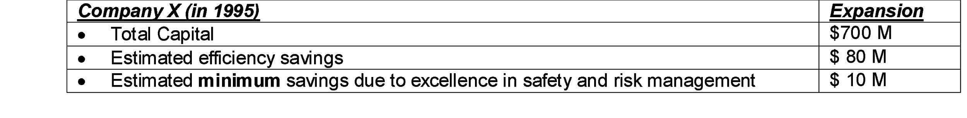
Good Proactive Risk Management Program is a Good Investment:
At 95% completion, about 4 million worker-hours accumulated
8 injuries over the course of the project, counting both medical treatment cases (MTC) and lost time injuries (LTI)
Recall the stated expectation of 4 to 5 fatalities for a project of this size without additional risk reduction solutions!
Actual Injury Frequency Rate: 0.40 including both MTCs and LTIs
For our purposes here, assume IFR = 0.40
Chapter 2.1: The Importance of Risk Management
8
Notes:
ENGG406 2015WENGG404 Lecture 00 - Day 1
8
8

Slide 9
Summary:
Risk Management is this important to you because:
CRITICAL to Success!
Avoid Loss Incidents:
On your projects / jobs and in your career, your job as an Engineer will be to manage and control risk!
A Good Proactive Risk Management Program is a Good Investment.
Application of the formula to calculate the Injury Frequency Rate
Chapter 2.1: The Importance of Risk Management
9
Notes:
ENGG406 2015WENGG404 Lecture 00 - Day 1
9
9

